Slide 1

THE BENEFITS OF NOISE IN NEURAL SYSTEMS: BRIDGING THEORY AND EXPERIMENT By - Mark D. McDonnell and Lawrence M. Ward
ELG-7172
Presented by – Anshul Mahajan (300093480) & Saumil Suhagiya (300045903)
Submitted to – Prof. Hilmi Dajani

Slide 2
Outline
Stochastic Resonance
Classical Stochastic Resonance Model
Stochastic Facilitation Framework
The Future of Stochastic Facilitation Framework
Experimental Studies
Implementation
Stochastic resonance in neural systems
Biologically realistic and unrealistic models
Stochastic facilitation: Future research
Bridging Theory and Experiments
A Relevant Paper
Conclusion

Slide 3
Stochastic Resonance
Stochastic Resonance (SR), is a phenomenon where the presence of noise in a nonlinear system is better for output signal quality than its absence.
That means whenever SR occurs, it must be true that
performance (noise + nonlinearity) > performance (nonlinearity)
Now, there are a few key terms that needs clarification:
Nonlinear : Noise cannot be beneficial in linear systems. It is only the more complex interactions between nonlinearities and randomness that can sometimes lead to SR.
Better : The performance measures of the processing or transmission of a signal should be improved.
Noise : It is mostly used to describe undesirable disturbances or fluctuations, and the concept of it being useful is quite contradictory.

Slide 4
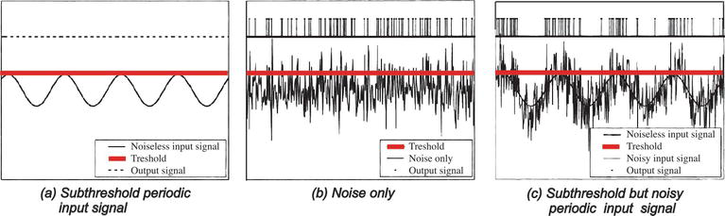
How Stochastic Resonance helps ?
Fig 1. System benefited from Stochastic Resonance

Slide 5
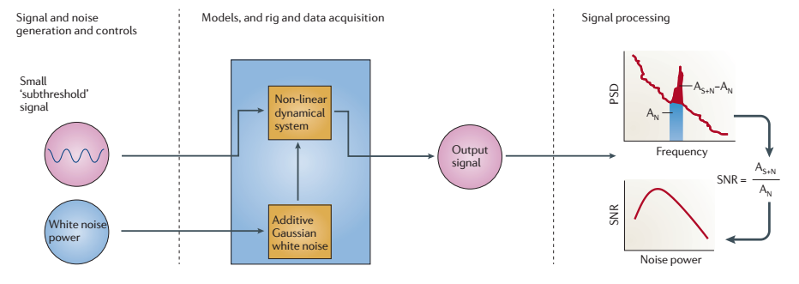
Classical Stochastic Resonance Model
Firstly, there is a weak periodic signal at the input of a dynamically non-linear system.
In the absence of noise, that weak signal also known as ‘Small Sub-threshold signal’ is not detected by the system.
Fig 2. Classical Stochastic Resonance Model

Slide 6
Classical Stochastic Resonance Model
For the input signal to be statistically detected , a noise is added to it, which is typically a white gaussian noise.
Finally, a signal is detected at the output and the quality of the detected signal is measured by output Signal to Noise Ratio (SNR) based on the Power Spectral Density(PSD) of the signal.
Typically, the SNR exhibits a single peak as the power of the noise is varied.
Fig 3. Classical Stochastic Resonance Model

Slide 7
Why stochastic facilitation?
Firstly, according to them, stochastic resonance was problematic in many ways.
Finding which phenomena can be labelled as stochastic resonance was not trivial.
And in broad sense the stochastic resonance only describes the noise induced peak in performance and not the frequency resonance.
Consequently stochastic resonance is often described as paradoxical or counter-intuitive because in engineered electronic systems, noise is seen to be detrimental to quality.
However in biological context, the effect is hardly counter-intuitive.
The most important question is though whether or when biological relevant noise benefits the neural system and if so, how ?

Slide 8
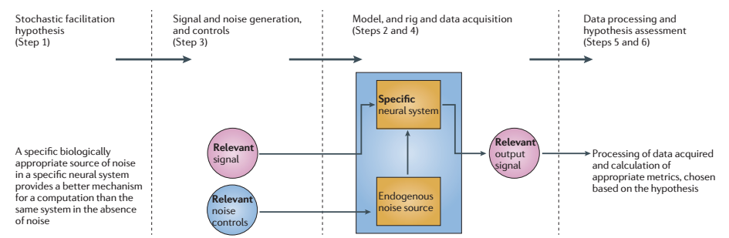
Stochastic Facilitation Framework
They developed a six step scheme to study stochastic facilitation in neural networks.
Fig 4. Stochastic Facilitation Framework

Slide 9
Stochastic Facilitation Framework
They developed a six step scheme to study stochastic facilitation in neural networks.
Step-1> Stochastic Facilitation Hypothesis
A hypothesis concerning the positive role of stochastic biological noise in facilitating signal processing or a computational task of a specified neural system is stated.
That means, a specific biologically appropriate source of noise in a specific neural system provides a better mechanism for a computation than a same system in absence of noise.

Slide 10
Stochastic Facilitation Framework
Step-2> Model
A neural preparation.
A mathematical or computational model
That can be stimulated by inputs relevant to the hypothesis and produce output responses that can be measured is specified.
Step-3> Signal and Noise Generation, and controls
Deals with the Signal and noise generation, and controls.
Hypothesis related input signal and noise that can be generated and introduced into, or deleted from, the experimental material or model are chosen.

Slide 11
Stochastic Facilitation Framework
Step-4> Data Acquisition
The input signals and noise that are selected in step 3 are introduced into the experiment rig or simulation of the model, the relevant output data are acquired.
Step-5> Data processing
The data thus acquired in Step 4 is processed in this step.
Step-6> Hypothesis Assessment
In this final step the hypothesis from step 1 is accessed based on step 5

Slide 12
In past studies..
According to them, in many past studies different steps were followed for the study of neural-system stochastic resonance.
Typically, the performance was measured by the output SNR of the neural system chosen. In this the output is a function of noise power which requires the input signal to be periodic.
The output was only defined in terms of times of action potential and the SNR based on output PSD.
The choice of SNR metric implies hypothesis that the computational role of the neural system is to produce a sequence of action potentials when periodic sinusoidal signal at a particular frequency is introduced in the system and to produce a statistically distinct pattern when it is absent.
And, thus cannot determine if there is the presence of the noisy periodic signal in the neural system.
In the stochastic facilitation theory, the hypothesis is rather stated in advance and investigated using only relevant, biologically appropriate signals and metrics.

Slide 13
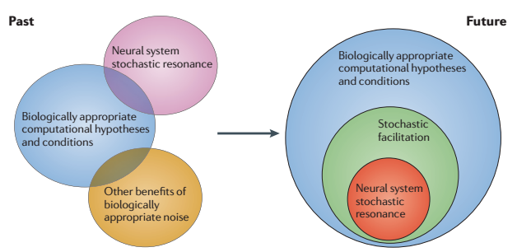
The future of stochastic facilitation framework
Past
Stochastic resonance has been isolated from other benefits of biologically appropriate noise.
Future
All possible constructive roles for biologically appropriate noise in neuroscience and all such research would be based on biologically appropriate computation hypothesis and conditions.
Fig 5. The future of stochastic facilitation framework

Slide 14
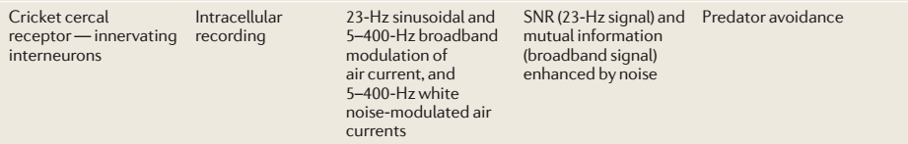

Experimental Studies of Stochastic Resonance
In this experiment, receptors were stimulated with air currents that were modulated either at single or multiple frequencies in the range of those caused by predator attack, and with noisy (broadband) air currents as would occur in a natural environment.
Both the signal-to-noise ratio and mutual information showed a maximum at intermediate (non-zero) levels of the added noise, thus indicating stochastic resonance in the broad sense.
Fig 6. Cricket

Slide 15
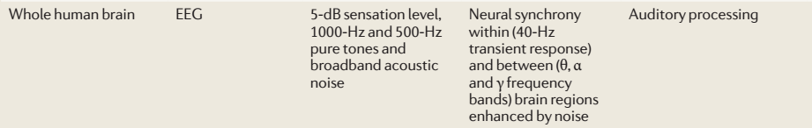
Experimental Studies of Stochastic Resonance
EEG detects synchronized neural oscillations and is enhanced by low levels of added noise.
In the experiment, broadband acoustic noise was added to the stimuli in the left ear but not to those in the right ear. Independent component analysis was used to identify independent signals localized to specific brain regions, and wavelet analysis was used to extract the amplitude and phase of the signals in specific frequency bands.
As a result synchronization within and between brain regions was enhanced for intermediate (non-zero) level of added noise.

Slide 16
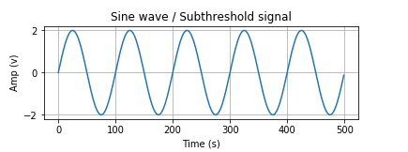
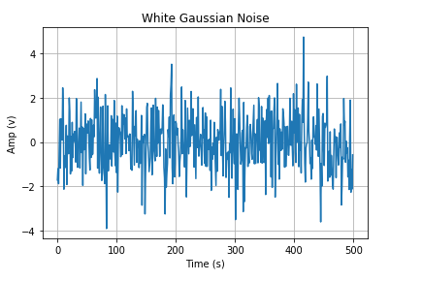
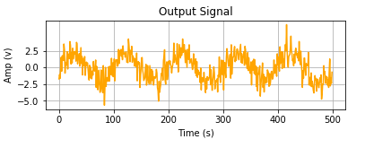
What we are trying to implement ?
We took a subthreshold signal.
Generated random white gaussian noise.
Added the noise to the signal using python’s signal processing.
Compare the output with the original signal.
Then, we performed this test with different magnitude of noise and compared their output’s as well.
Fig 7. Implementation

Slide 17
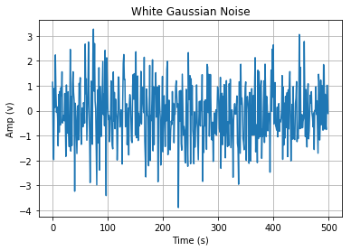
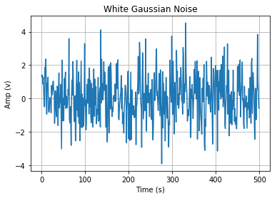
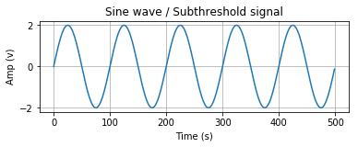
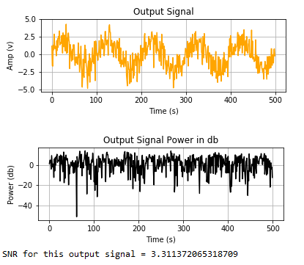
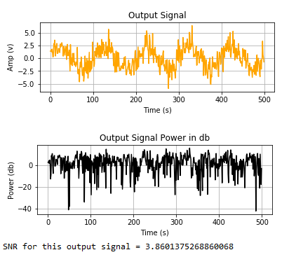
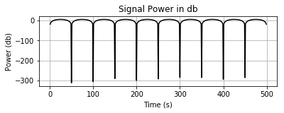
Results:
Fig 8. Subthreshold Input
Fig 9. Output with 1st noise level
Fig 10. Output with 2nd noise level

Slide 18
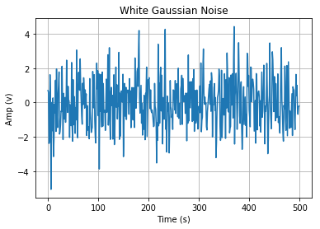
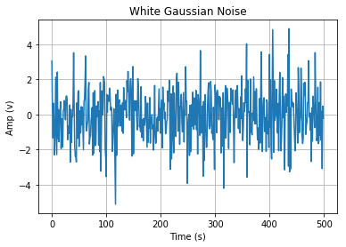
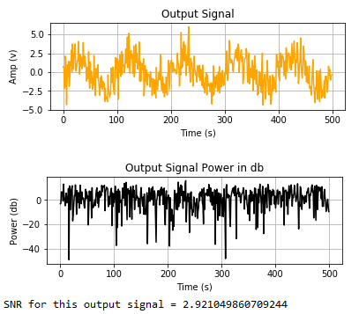
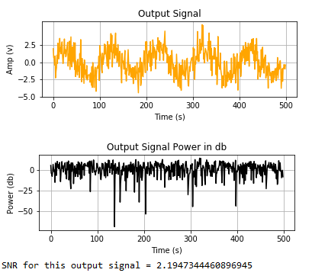
Results:
Fig 11. Output with 3rd noise level
Fig 12. Output with 4th noise level

Slide 19
Stochastic resonance in neural systems
Number of neural systems has been studied for different range of size scales, different organism including wide range of in vivo functions.(sensory reception, memory)
Different data collection techniques:
Extracellular recordings
Electroencephalography and Magnetoencephalography
Effects of noise on signal-to-noise ratio at the signal frequency.
Additional measures have taken into consideration, such as coherence or synchronization, vowel coding, reflex output, heart rate and neural entrainment, and evoked potentials.
Researchers have tried to simulate natural signals such as water movements, air currents or electric fields generated by predators or prey, limb movements, sounds, lights or touches.

Slide 20
Biologically realistic and unrealistic models
Five levels of abstraction detail have been identified for single neurons.
Detailed compartmental,
Reduced compartmental,
Single compartment or point neuron,
Cascade and black box.
Stochastic resonance is not related with a particular level of model.
Classical definition of stochastic Vs New definition
Performance metrics were chosen based on signal so, the choice of signal is very important.
Neurons are channels that should communicate input spike trains, in the sense that a spike train that arrives at a neuron should be reproduced precisely by the neuron’s own spikes.
Further investigation in new biological hypotheses is required in order to obtain biologically appropriate models of neural systems and noise sources.

Slide 21
Stochastic facilitation: Future research
Building realistic models with realistic noise:
There are many different sources of stochastic biological noise.
Thermal noise | Johnson noise, arises from random thermal agitation of charge carriers in electrical conductors, and appears as fluctuations in membrane potentials.
Stochastic molecular diffusion | Molecular interactions during calcium signaling in dendritic spines is inherently stochastic owing to diffusion, with potentially important consequences for synaptic plasticity.
Ion channel gating and membrane noise | The stochastic nature of the opening and closing of ion channels is well known. This leads to fluctuations in neuron membrane potentials, and in turn affects action potential generation.
Synaptic barrages | Pyramidal neurons can have many thousands of synaptic connections with other neurons, and the numerous input events from these can lead to the neuron’s membrane potential being in a state of increased or decreased, or fluctuating, conductance. This can have profound effects on the neuron’s spiking properties.
Diversity owing to stochastic gene expression | Intrinsic biophysical properties vary over populations of neurons and have been shown to benefit neural coding. The notion that this kind of variability can lead to benefits is sometimes called diversity-induced resonance.
Network connectivity | Cortical neurons form connections with many other cortical neurons to form irregularly structured networks.
Sensory inputs | Disturbances can be extrinsic (such as background visual clutter) or intrinsic to biological transduction mechanisms.
Motor noise | Movements induced by muscle fibers are subject to variability through several mechanisms

Slide 22
In case of a signal, not every variability considered as a noise and can be utilized for the studies in stochastic facilitation.
It is necessary to check that whether observations of random noise or background fluctuations may be evidence of a source of biological randomness that is potentially exploited in vivo for stochastic facilitation.
In order to build a realistic model, it is utmost important to consider various factors that can affect the proposed computation goal of the system.
Which includes-
the level of detail
neuron type (e.g excitatory, inhibitory or bursting)
synaptic activity and any neuron-to-neuron connections.
The choice of additional elements could be based on mathematical or numerical tractability, elegance, symmetry, completeness or other considerations.
The noise source should also help to determine which model elements are essential.

Slide 23
It is also important to choose a signal which is biological appropriate.
For example, whereas the output signal in stochastic resonance work is often a sequence of action potentials in response to an input current, other signals for a computational process might be biophysical entities, such as neurotransmitters from synaptic vesicles, or calcium currents.
Another viewpoint comes into picture that, stochastic facilitation may not require an input signal. (e.g model of brain functional networks)
Although the lack of signal means that calling this effect stochastic resonance redefines the term known as coherence resonance.
Also it is important to distinguish between the signal and noise for the computation hypothesis.
it is often assumed that a signal is independent of any noise source.

Slide 24
Bridging Theory and experiments
Stochastic facilitation is observed within a specific neural system if a proposed computational goal is better achieved in the presence of random fluctuations originating from stochastic biologically relevant noise than in their absence.
Biologically appropriate computational role of a neural system needs to be analyzed, as well as biologically relevant indicator of performance, in order to detect whether stochastic facilitation occurs or not.
In computational studies two approaches has been studied.
The goal of Physical approach is to predicts the existence of stochastic resonance in neural systems.
whereas the focus of neuroscience approach is to determine basic mechanisms that are actually realized in specific neural systems of living organisms.

Slide 25
Take a look at some experiments in which experimentally modification in noise and then applying stochastic facilitation hypotheses leading to new or alternative conclusions.
In the study of Mazzoni et al, his model simulates some aspects of the structure and function of the V1 region of visual cortex as it receives inputs from the lateral geniculate nucleus (LGN) of the thalamus.
The computational goal of the LGN is to transmit the information that it receives about the spatial and temporal distribution of light on the retina to V1.
A performance is measures by the total mutual information between the LGN-generated noisy signal and the resultant V1 activity integrated across spatial location, time slices and frequency channels.
He also tried different approach by introducing V1‑specific noise, for example, from synaptic bombardment, and manipulate the amount and nature of that noise.
At the end he finds that noise affects the mutual information and without noise the results were less reliable, which shows that the noise plays an important role for the successful achievement of the computational goal.

Slide 26
Bezrukov and Vodyanoy established that external electric noise (artificially generated) can facilitate transduction of weak sine wave signals through the alamethicin channel in a lipid bilayer.
They used a physics approach and as a performance metrices they considered Lorentzian power spectrum and SNR in output power spectrum.
They showed the dependence of the signal-to-noise ratio on noise level in the form of mathematical expression.
Another study done by, Ward and colleagues in which they described stochastic resonance-modulated synchronization of the whole human brain.
In which they found that adding near-threshold broadband acoustic noise to a brief weak pure tone stimulus resulted in an increase in both local and global synchronization.
In this study, although the performance metric was unique (synchronization within and between brain regions) these models were not addressed directly except to predict the general effects of the noise.

Slide 27
A Relevant Paper (2018)
Stochastic Resonance in neural network, noise color eﬀects
Alexandra Pinto Castellanos∗
ETH/UZH Zurich
(Dated: 2 de octubre de 2018)
The SR is detected when there are weak periodic signals that are added to diﬀerent noise colors in order to be ampliﬁed and optimized.
The interactions between the two signals transform the potential of the system precisely at the frequency of the weak periodic signal that is added to the system.
Pink noise is most common in biological systems.
The behavior of the SR is detected in a neural network and it is study under noise color variations where Pink noise ampliﬁed the signal many orders of magnitude more than white noise.

Slide 28
CONCLUSION
At the end it is noticeable that, It is not necessary and also sometimes meaningless, to define performance in terms of signal-to-noise ratio.
Also the physical approach of SR does not give proper understanding of benefits of noise in neural system.
More experiments in the study of the constructive roles of biologically relevant noise may leads to better understanding and diverse viewpoints in other areas of neuroscience.

Slide 29
References
[1] Mark D. McDonnell and Lawrence M. Ward, "The Benefits of noise in neural systems: Bridging experiments and theory" VOLUME 12, JULY 2011, 2011 Macmillan publishers ltd.
[2] Ling Wang and Peng Miao" Iterative Stochastic Resonance Model for Visual Information Extraction from Noisy Environment" 2018 3rd IEEE International Conference on Image, Vision and Computing.
[3] Serletis, D. (2011). "Complexity in neuronal noise depends on network interconnectivity". Ann Biomed Eng. 39 (6): 1768–1778.
[4]Jiří Náprstek and Cyril Fischer (November 29th 2017). Stochastic Resonance and Related Topics, Resonance, Jan Awrejcewicz, IntechOpen, DOI: 10.5772/intechopen.70178. Available from: https://www.intechopen.com/books/resonance/stochastic-resonance-and-related-topics
[5] Mark D. McDonnell, Derek Abbott “What Is Stochastic Resonance? Definitions, Misconceptions, Debates, and Its Relevance to Biology” May 2009, Volume 5, Issue 5, e1000348, PLoS Computational Biology.

Slide 30
THANK YOU !
ANY QUESTIONS ?

